Slide 1
INTRODUCTION to BIG
BAND
BANG
DATA
Yabebal Fantaye Bruce Bassett Pierre-Yves Lablanche
Notes:
Hello! My Name is Yabebal Fantaye and I am from Ethiopia. Currently I am a post-doc in the department of Mathematics at the University of Rome Tor Vergata, Italy. The topic of my proposal is Big Data for Astronomy and Industry.

Slide 2

BIG BAND: type
associated with jazz and the Swing Era typically consisting of percussion, brass, and woodwind instruments totalling approximately 12 to 25 musicians

Slide 3
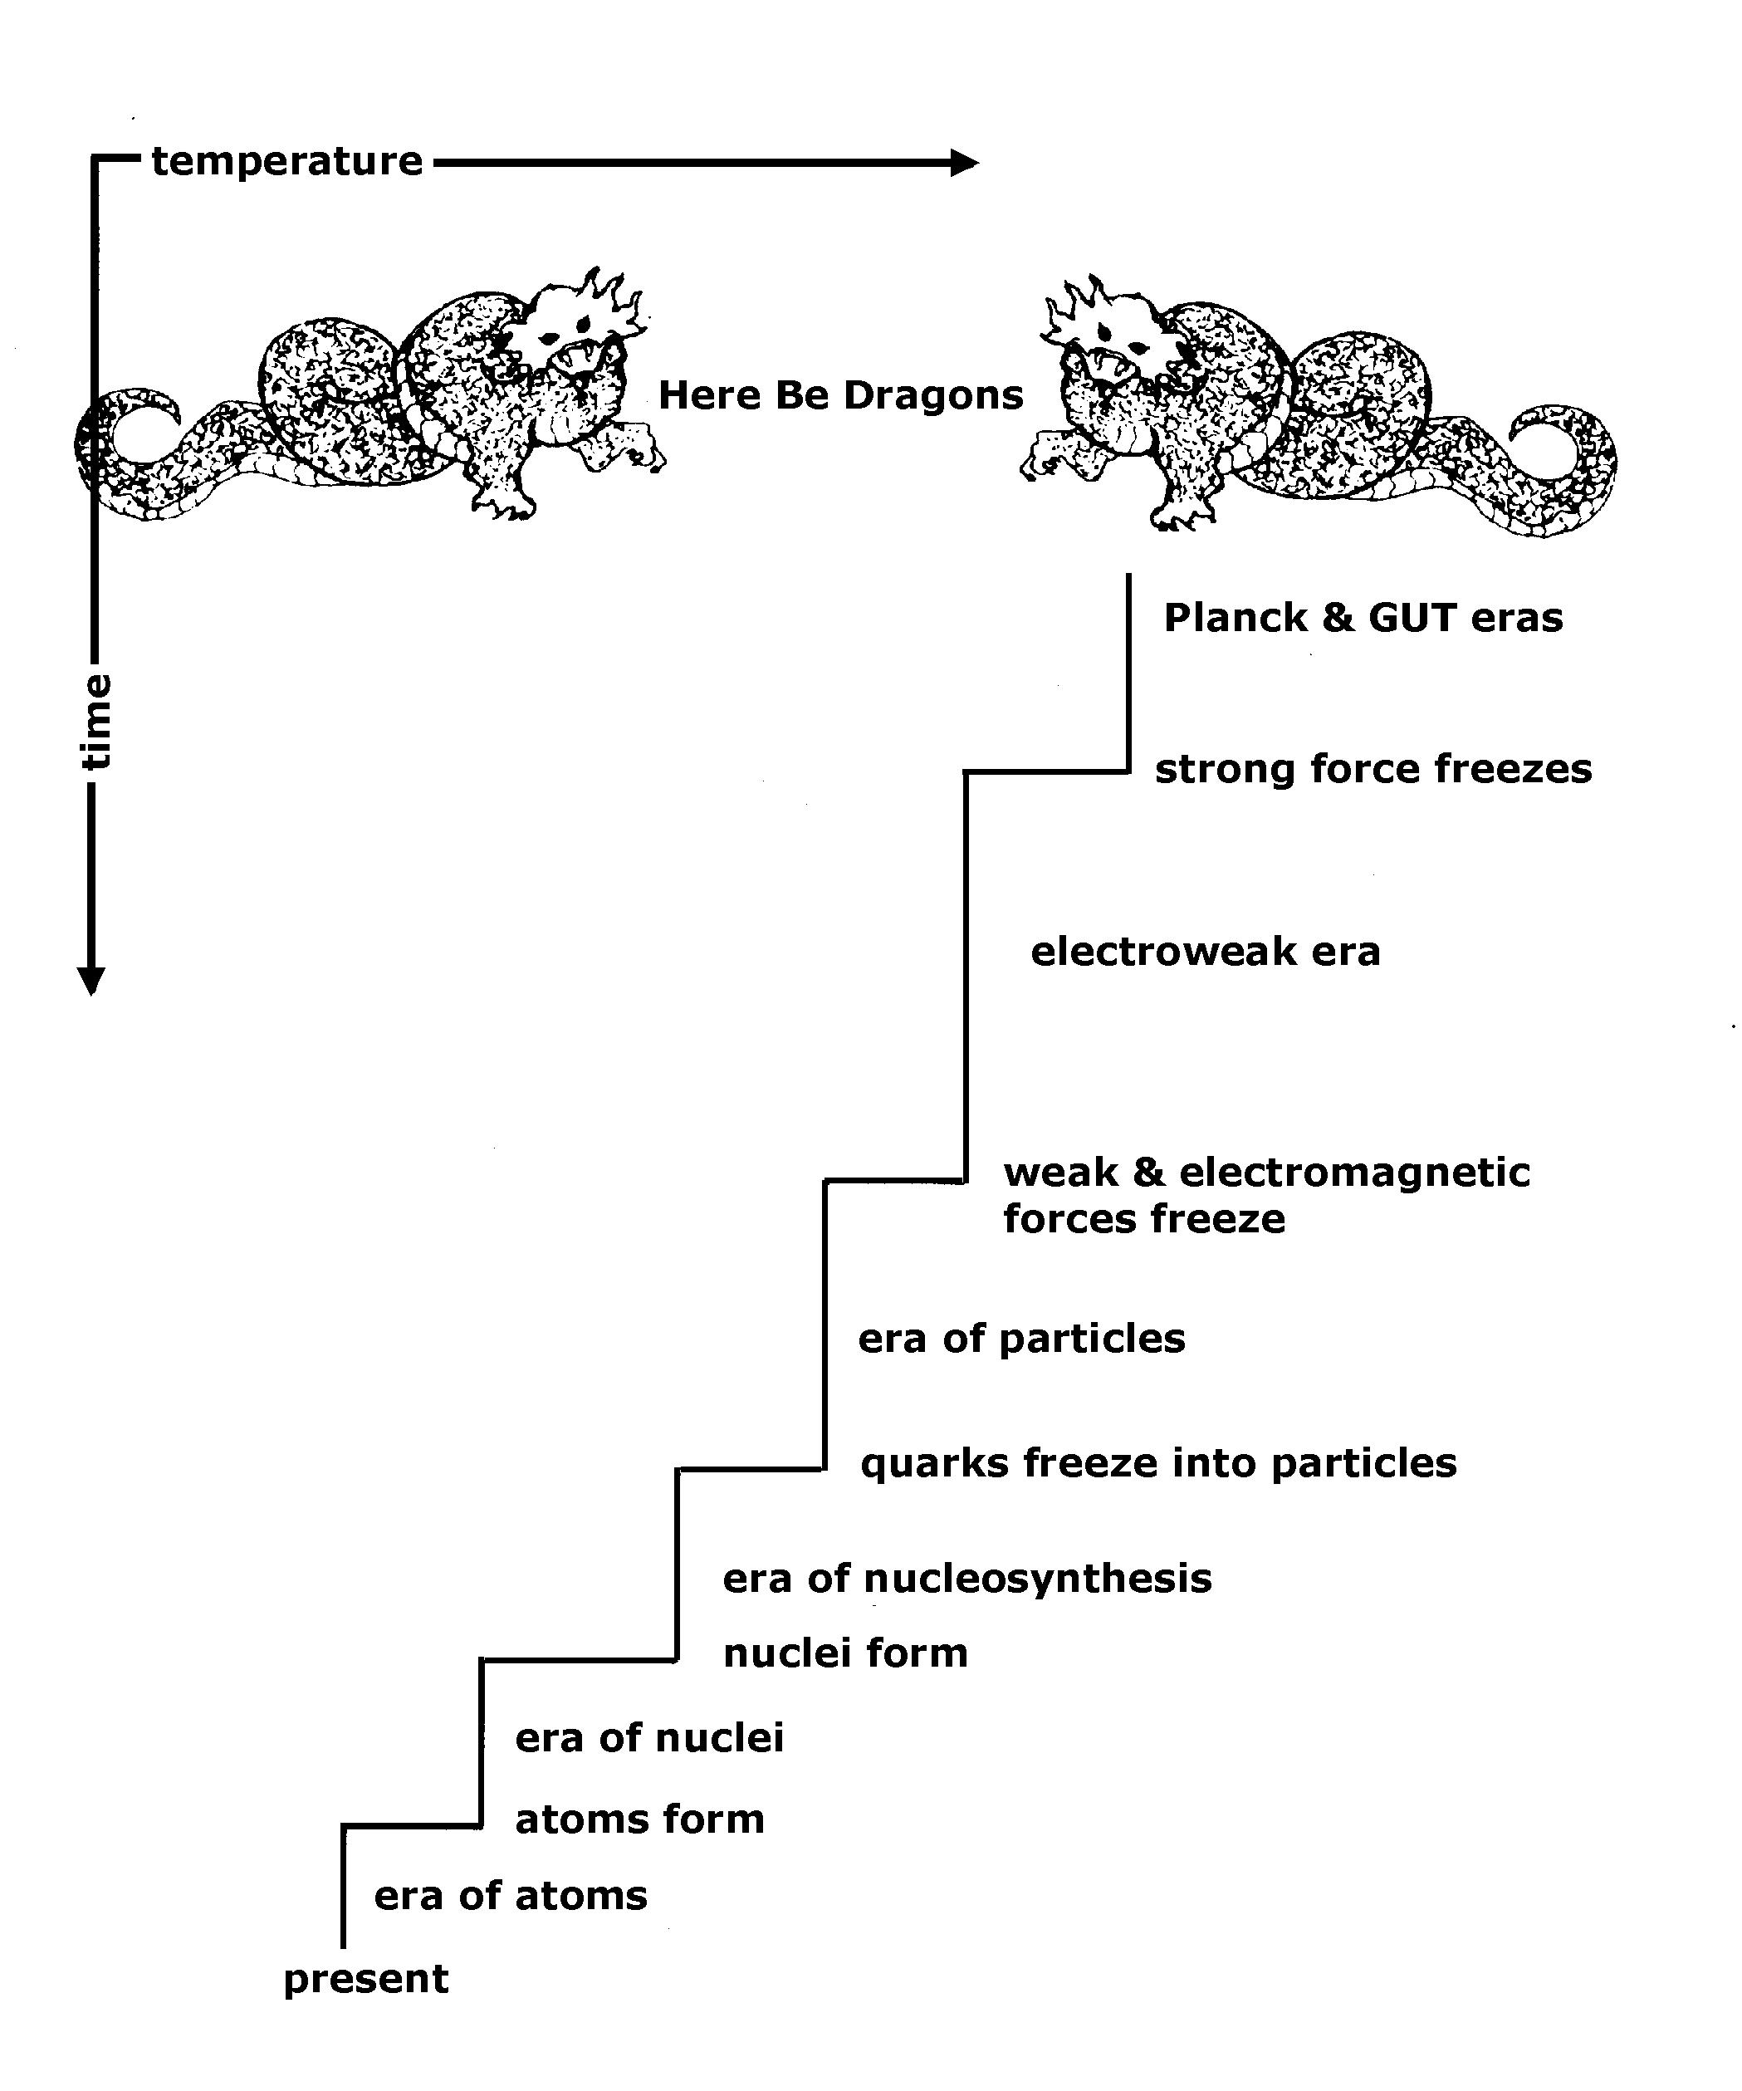
BIG BANG: model
http://ircamera.as.arizona.edu/NatSci102/NatSci102/text/whybigbang.htm

Slide 4
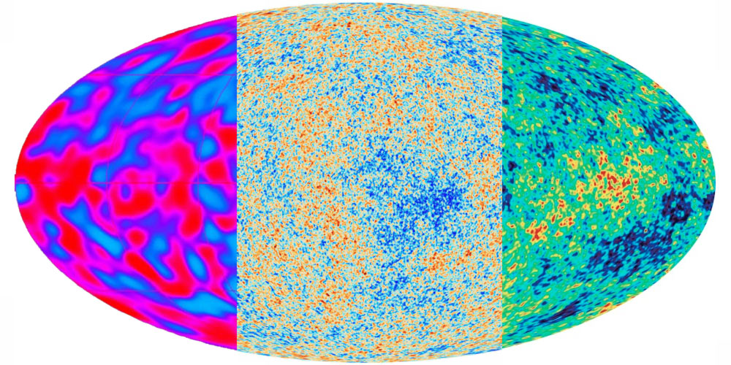
1
1000
100 (TeraBytes)
COBE
1993
PLANCK
2015
WMAP
2004
ESA & NASA
COSMOLOGY | THE EVOLUTION
Notes:
I am a cosmologist heavily involved in the development of Mathematical and Statistical tools for the analysis of the Cosmic Microwave Background (CMB) data. The CMB is the earliest fossil left from the Big Bang process. It was first detected by the COBE satellite in 1992, which won the 2006 Nobel prize in physics. The WMAP experiment with 30 times high resolution than COBE was instruments to lay down the standard model of cosmology. Planck with its unprecedented resolution and low noise has given us the most detailed picture of the Universe every seen.
The ESA led Planck satellite sampled the full sky 1000 times a second, resulting with about 2trillion samples in its 3years life time. As one of the Planck consortium core team member, I had the opportunity to participate in this exciting endeavor of understanding our cosmos, and analyzed its order of a petabyte data with top super computers.

Slide 5
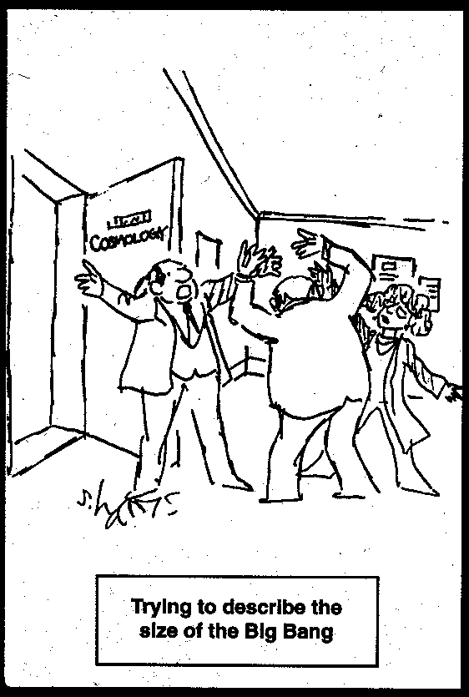

Slide 6
BIG DATA?
Notes:
Label
Era
Framework
Engine
<number>

Slide 7
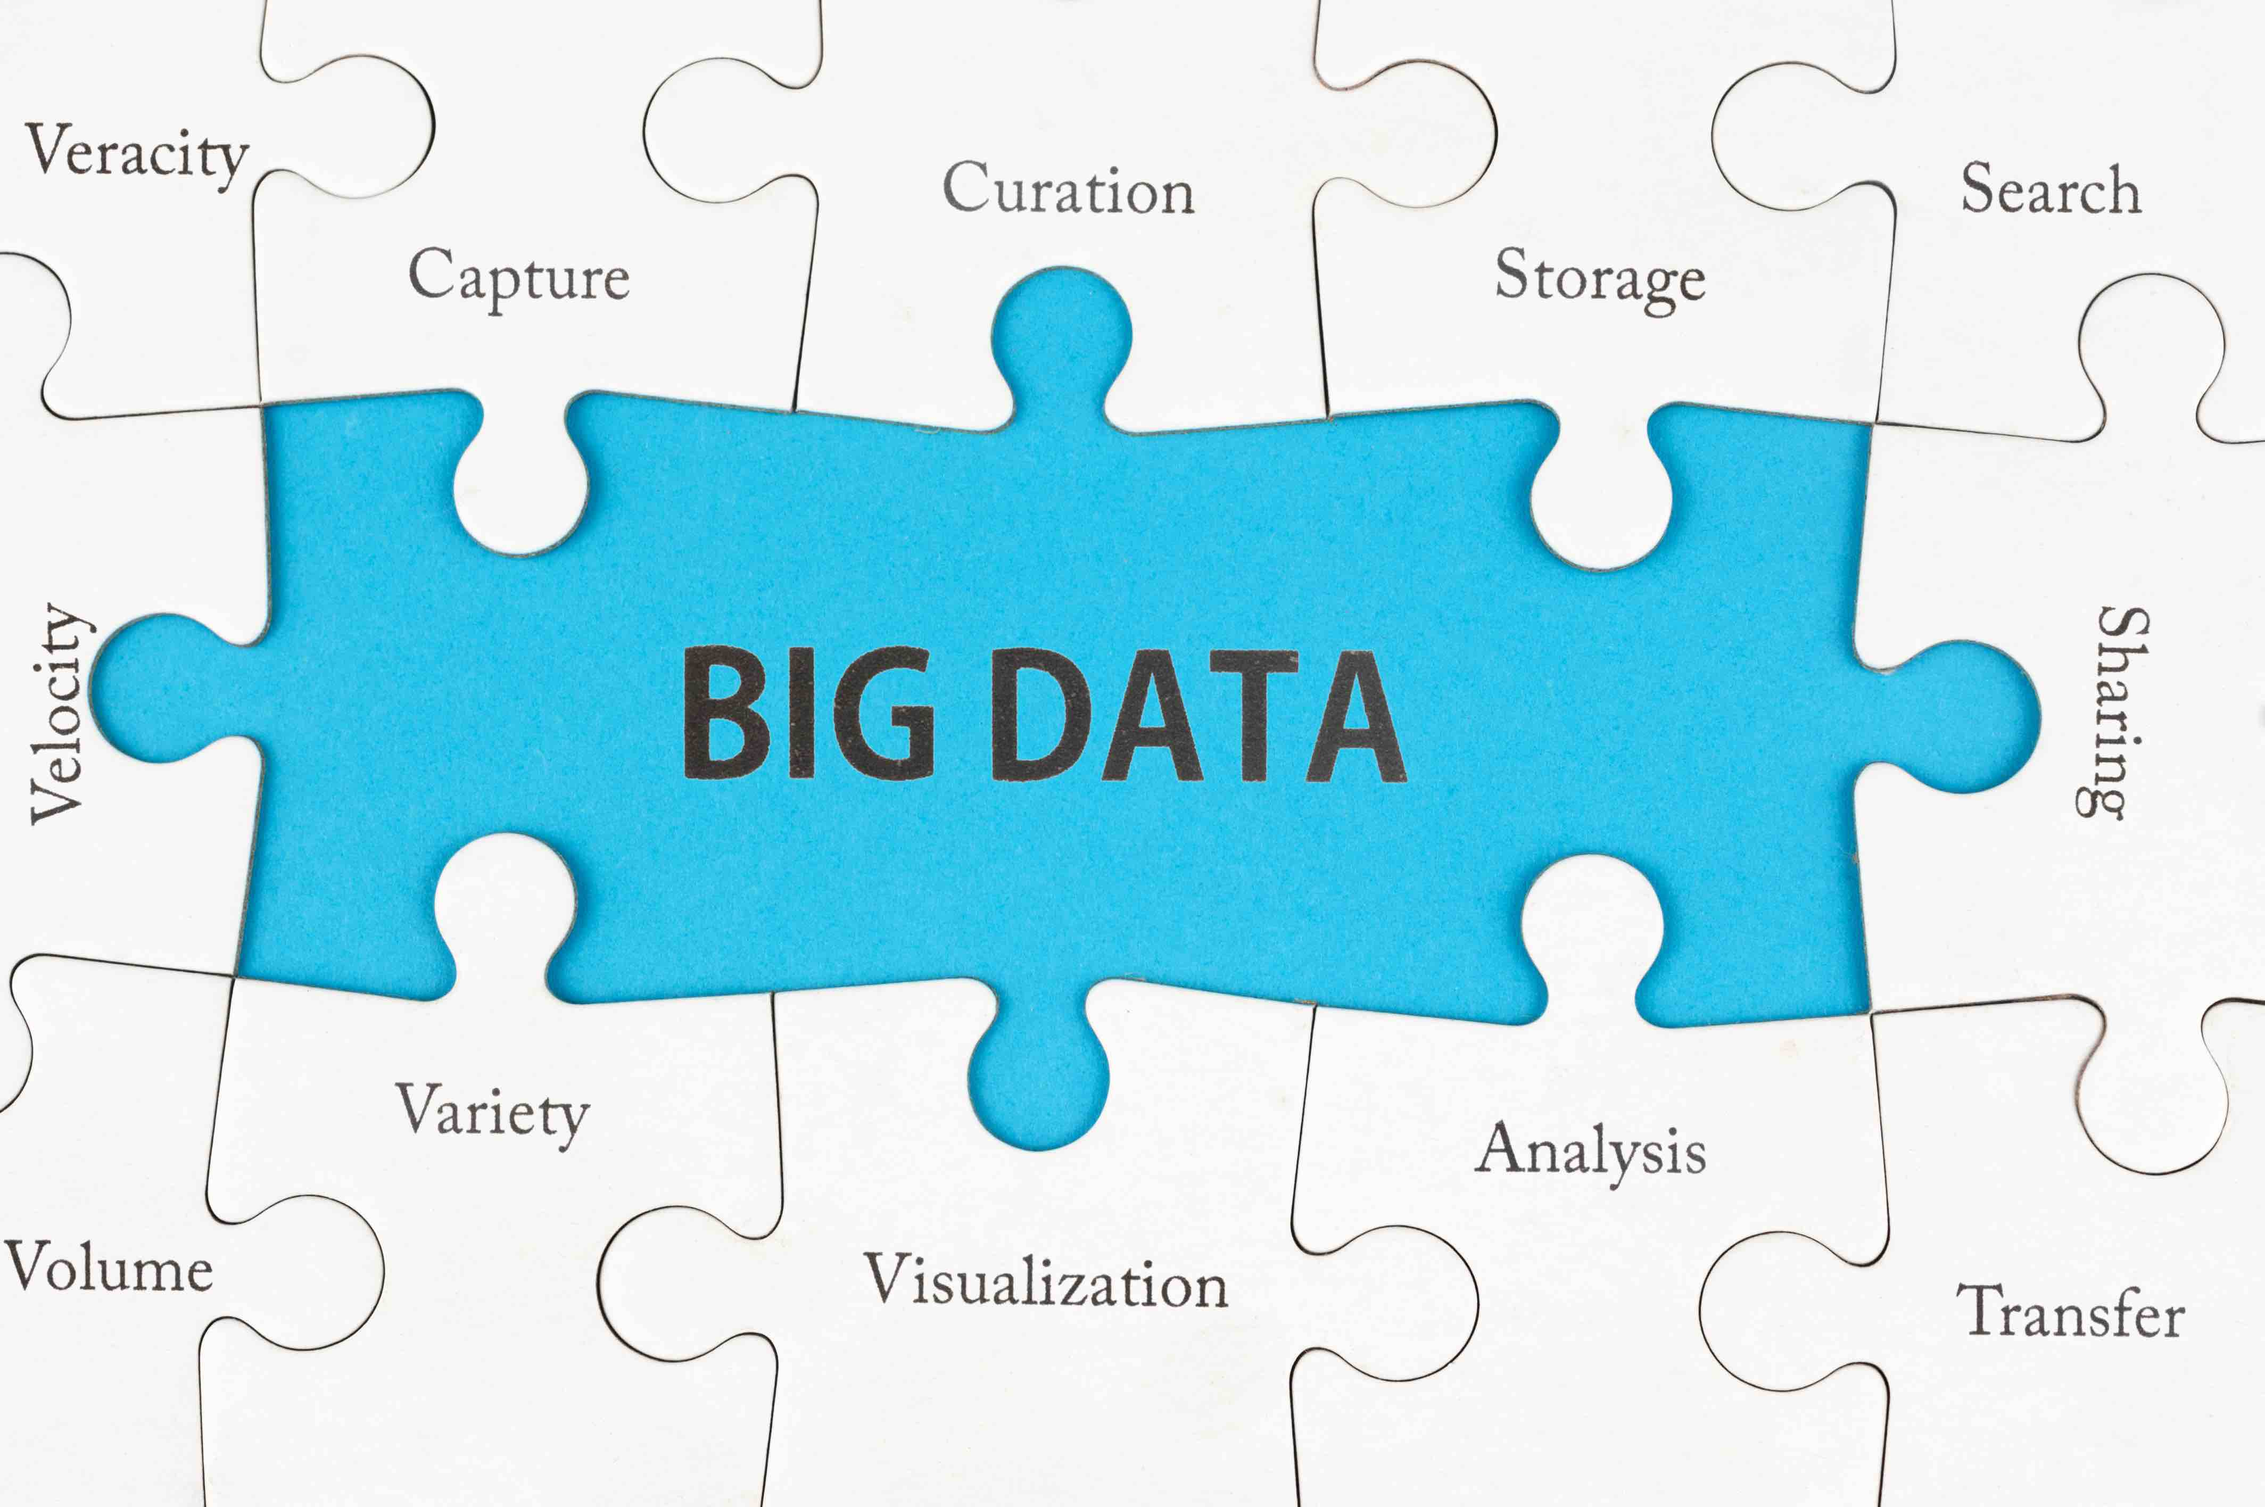

Slide 8
Outline
Characteristics
Use cases
The secrete of Big Data
Requirements

Slide 9
BIG DATA CHARACTERISTICS
Notes:
Label
Era
Framework
<number>

Slide 10
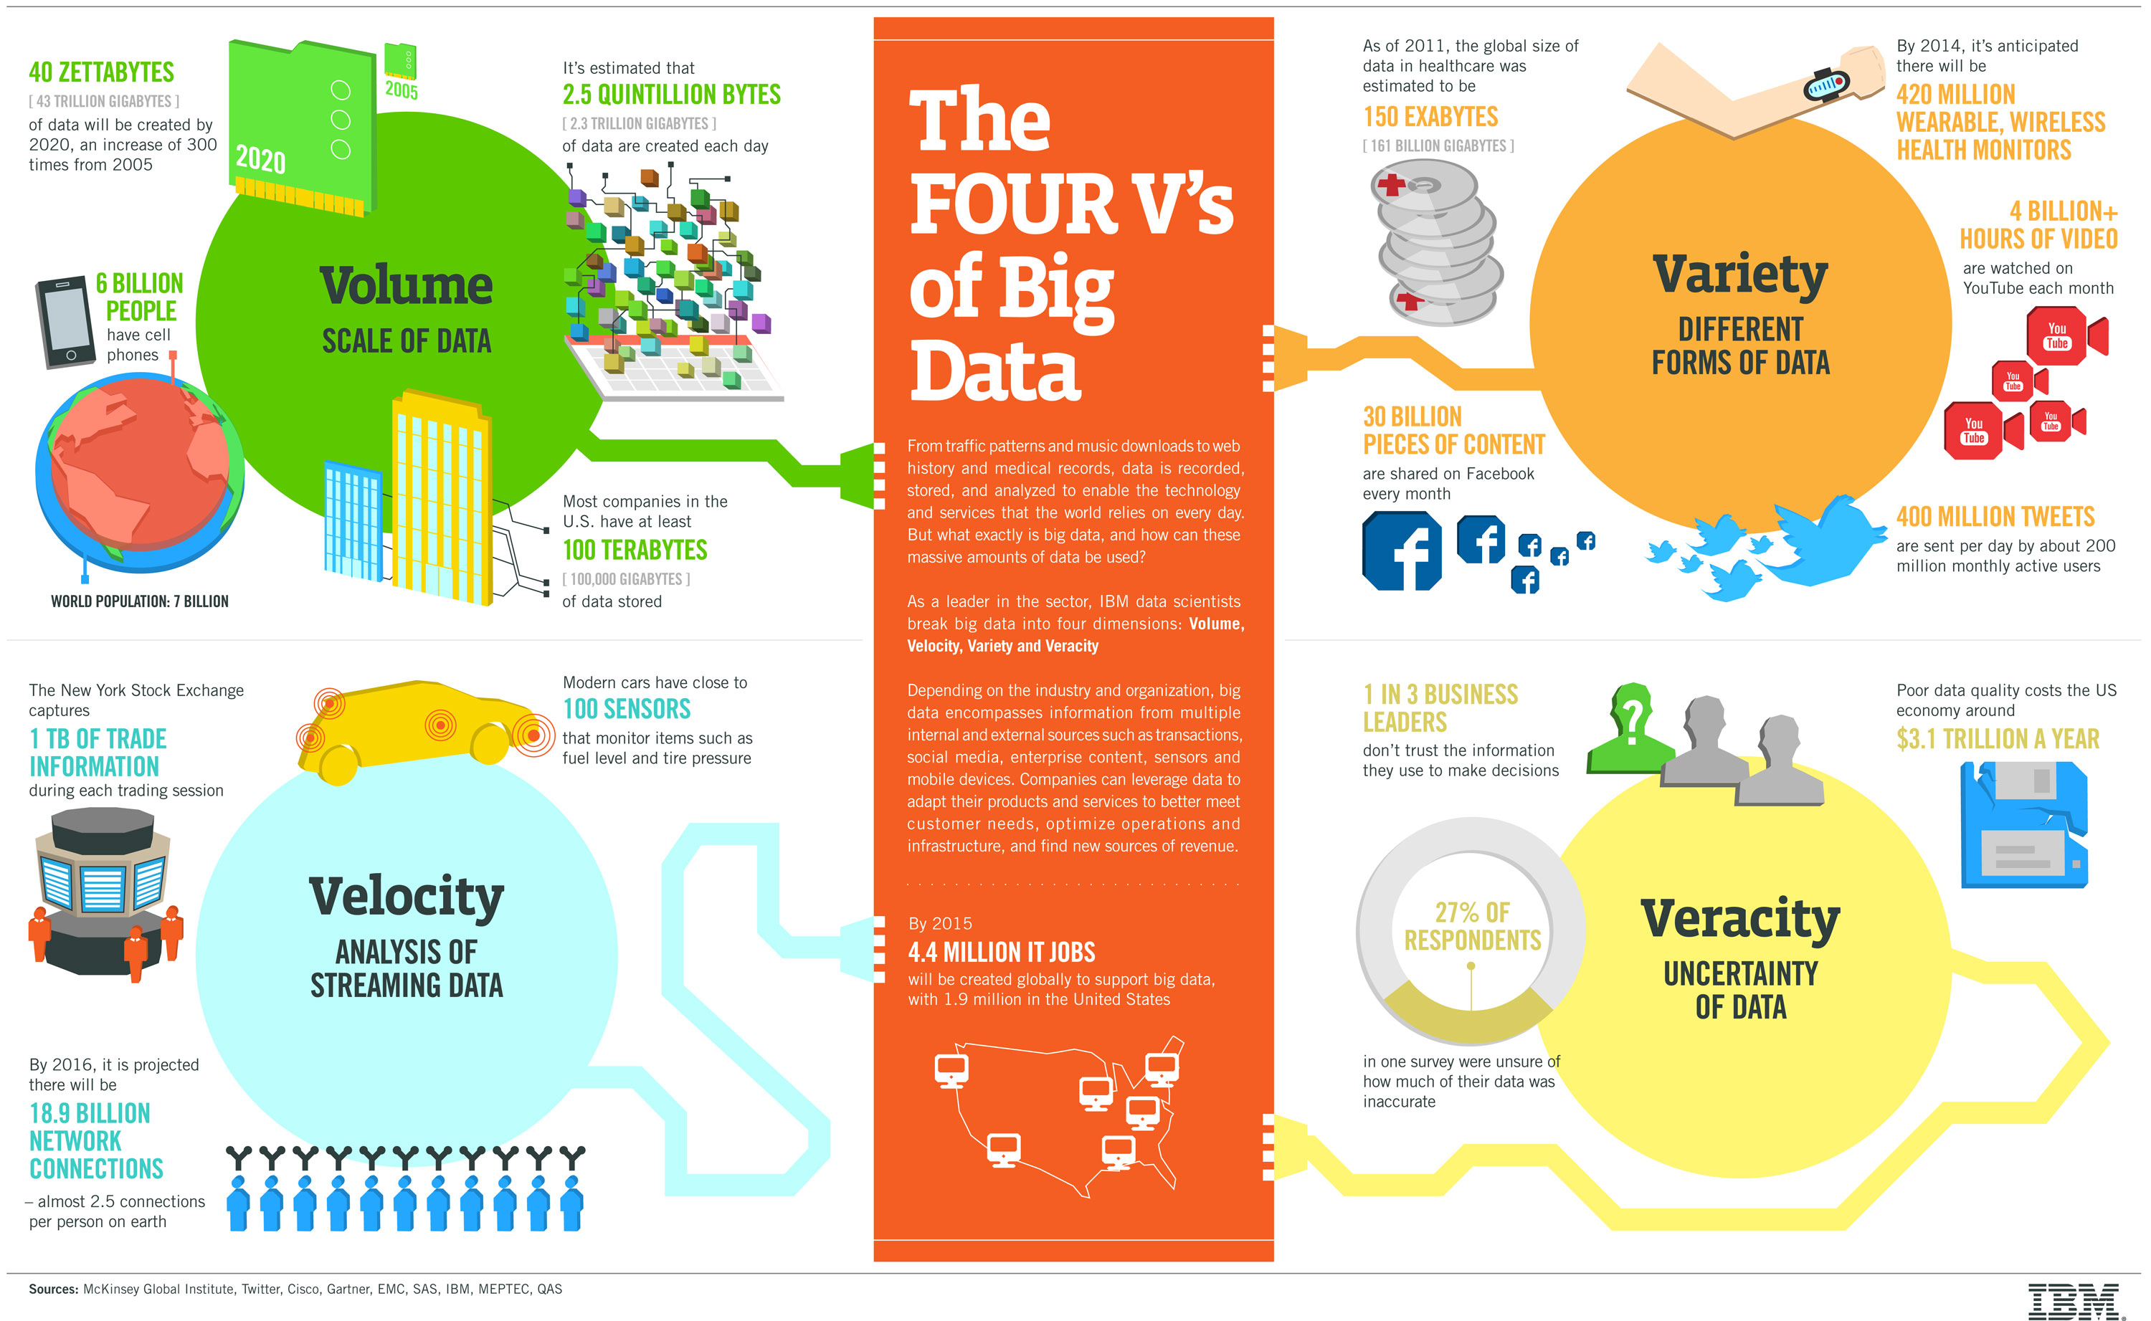
IBM

Slide 11
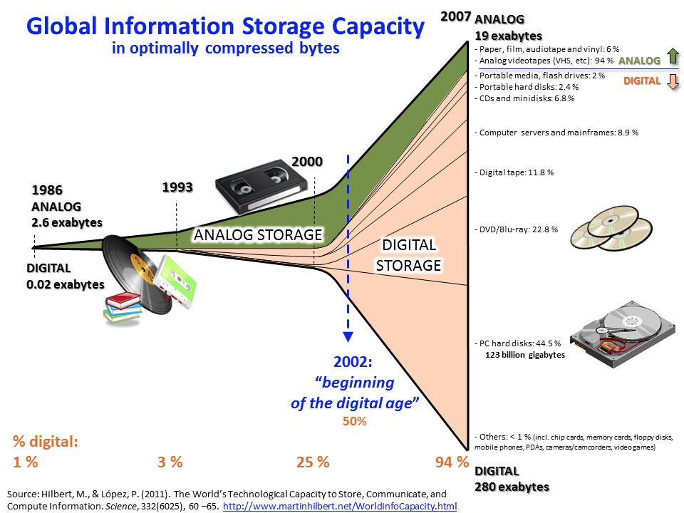

Slide 12
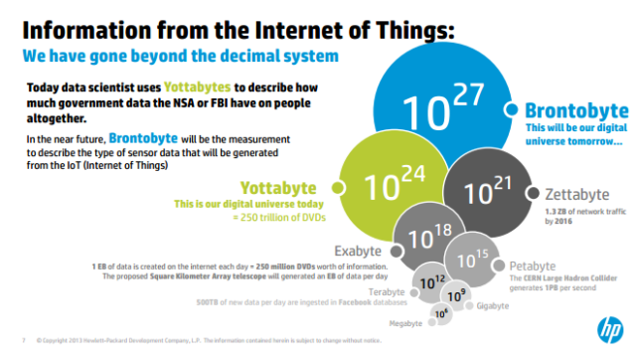

Slide 13
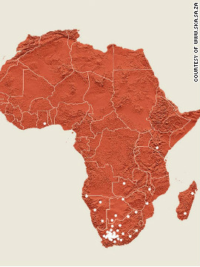
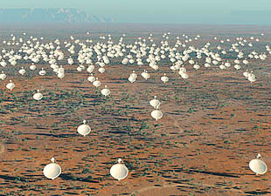
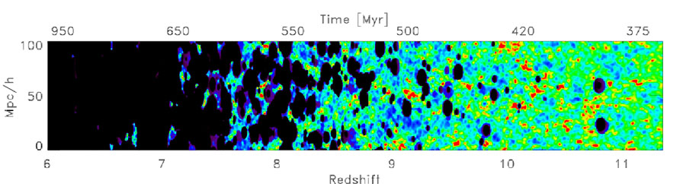
1 EXABYTE PER DAY
1,000,000,000,000,000,000
SKA | AFRICAN REVOLUTION
Notes:
One of the main goal of my proposal is to carry out world-class research on Machine learning and other efficient Mathematical and Statistical algorithms for Big Data analysis. My other major focus is teaching, training and supervising students on advanced Big Data algorithms and High Performance Computing skills.
Big Data is defined as high velocity, high-volume and high-variety information assets that demand cost-effective, innovative forms of information processing for enhanced insight and decision making . ​
It incorporates the necessity of HP.
Science is generic, the Big Data algorithms and tools I develop will be easily applied on Astronomy and Industry data. In particular for the Astronomy, I am targeting Big Data from SKA as well as the ESA satellites Planck and Euclid, which I am already a member. For the industry I will be targeting social network and open source African data.

Slide 14
IBM

Slide 15
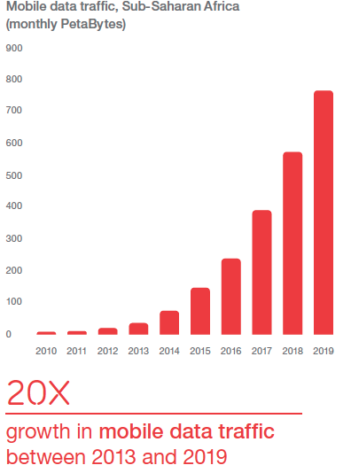
WHY?
WHY?
Ericsson ConsumerLab (2013)
FUTURE OF AFRICA
Notes:
African Social Data is growing extremely fast, and Big Data skull is crucial to efficiently utilize this data for addressing key developmental issues.

Slide 16
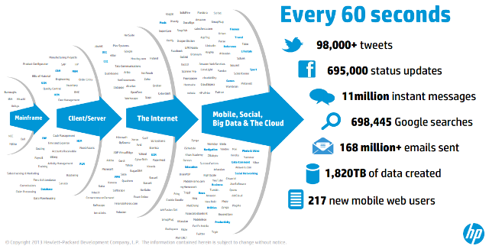

Slide 17
IBM

Slide 19
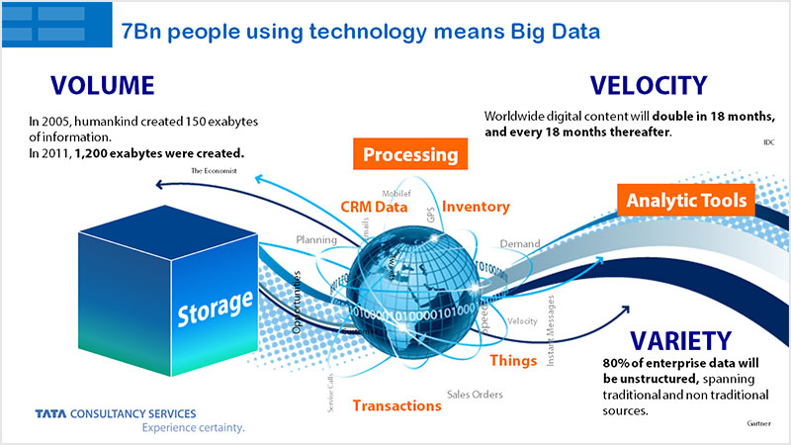

Slide 20
Discussion
What are the sources of Big Data in Africa?

Slide 21
BIG DATA USE CASES
Notes:
Label
Era
Framework
<number>

Slide 22
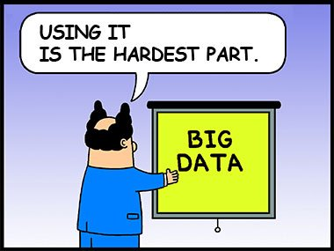

Slide 23
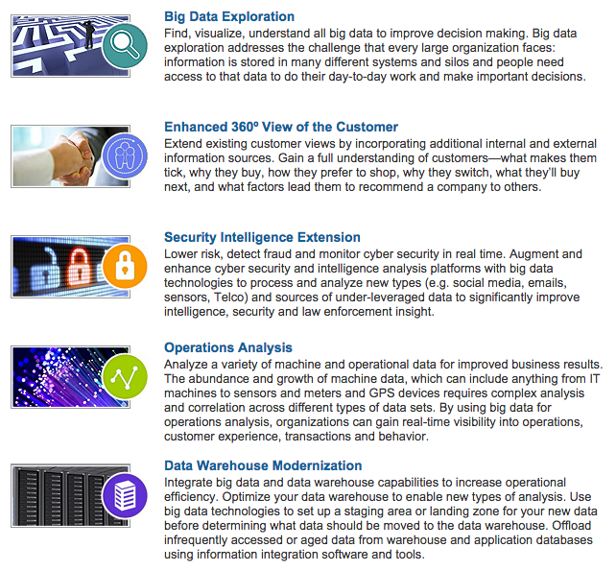
Big Data use cases
IBM

Slide 24
Big Data Use Cases II
Telecommunications Use Cases
Revenue assurance and price optimization
Customer churn prevention
Campaign management and customer loyalty
Call Detail Record (CDR) analysis
Network performance and optimization
Mobile User Location analysis
Government Use Cases
Fraud detection
Threat detection
Cybersecurity
Compliance and regulatory analysis
E-Commerce Use-Cases
Cross-Channel Analytics
Event Analytics
Recommendation Engines using Predictive Analytics
Right Offer at the Right time
Next Best Offer or Next Best Action (Ebay, Netflix, Amazon and Others)
https://pramanicks.wordpress.com/tag/use-cases/

Slide 25
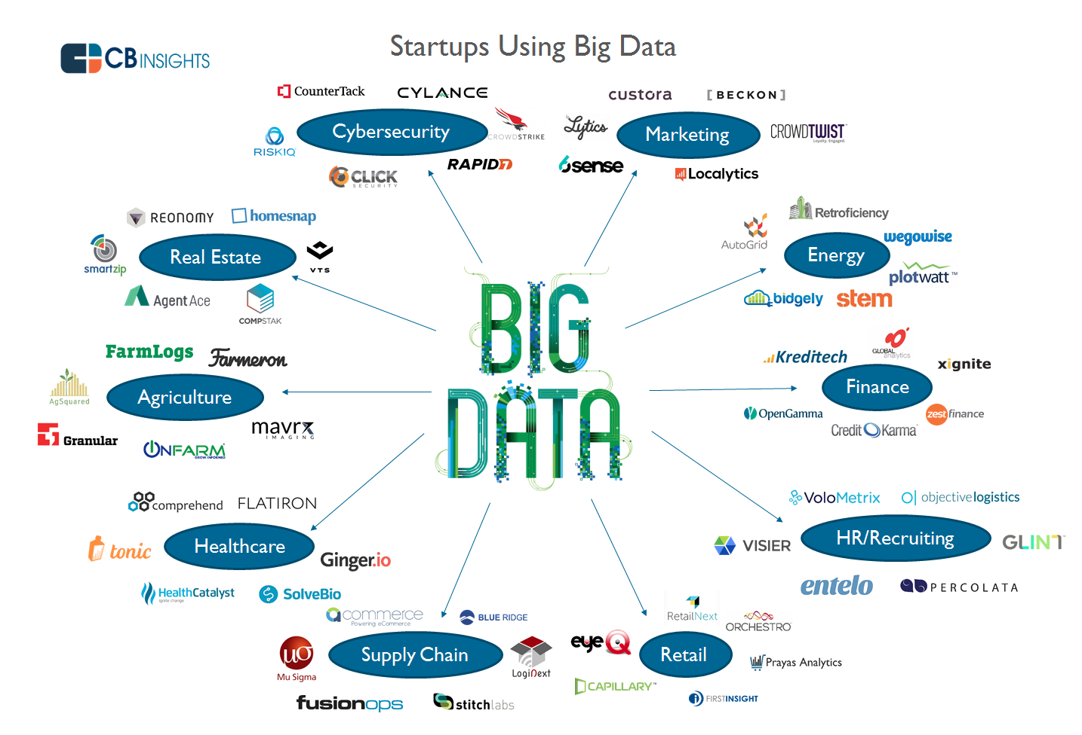

Slide 26
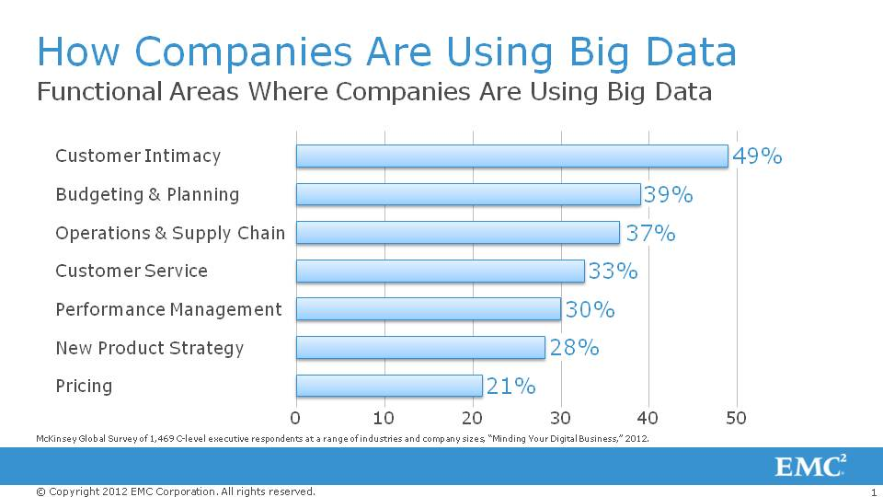

Slide 27
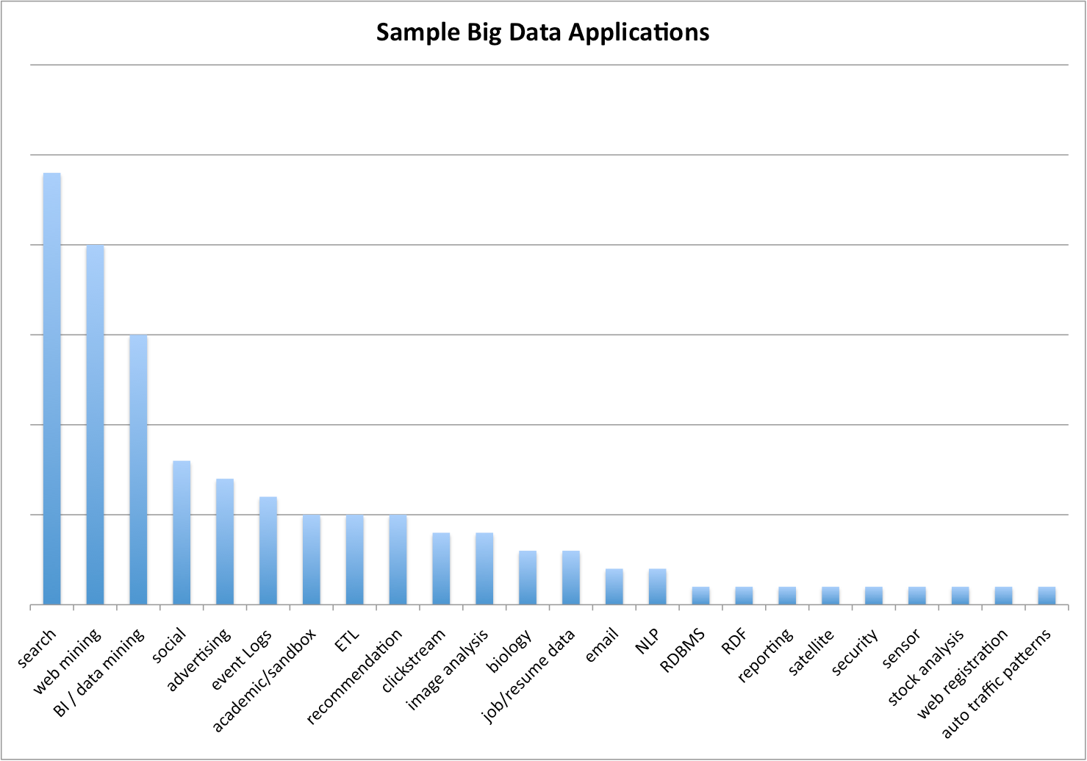
BIG DATA use-cases / applications from a sample of over 100 companies
http://jameskaskade.com/?p=2088

Slide 28
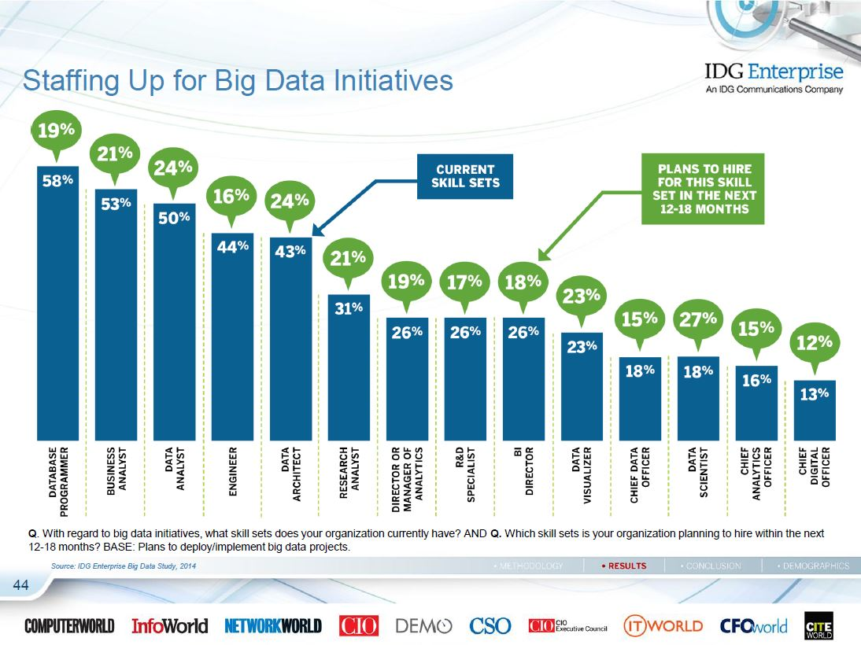

Slide 29
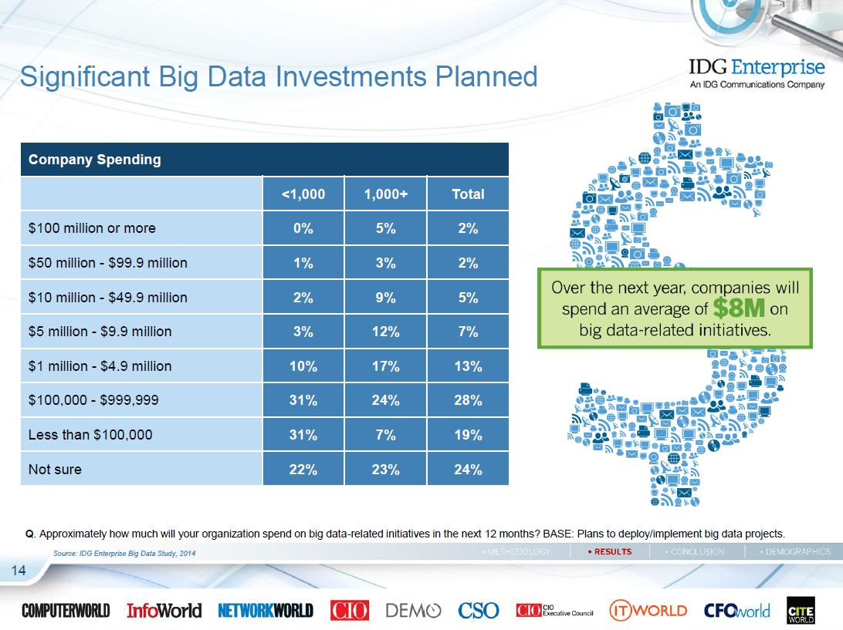

Slide 30
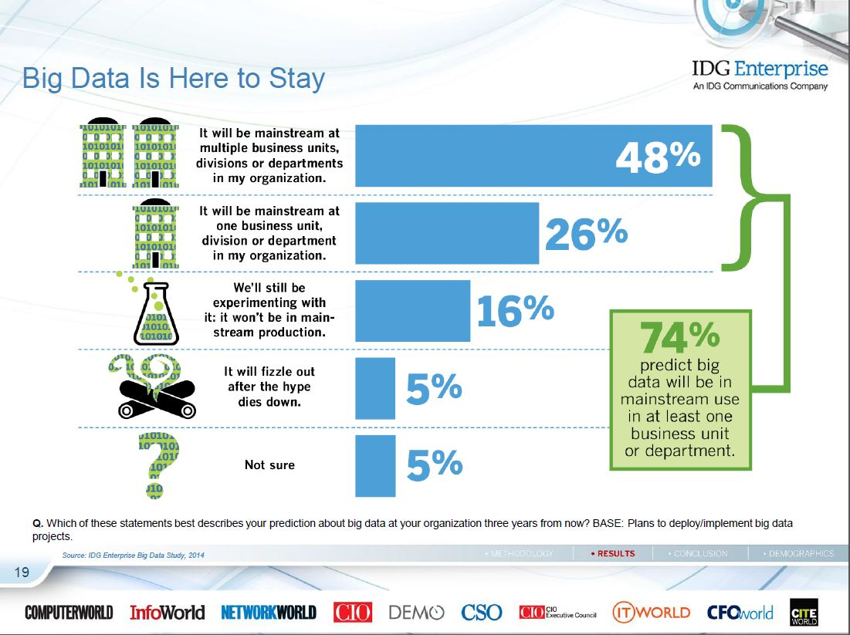

Slide 31
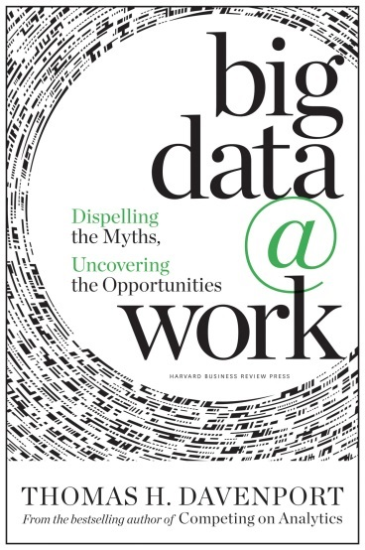
What separates Big Data from past marketing trends like online analytic processing (OLAP) or business intelligence (BI)?
“the unstructured nature of Big Data does put it in a different category. Basically, what it means is that you have to do a lot of things before you can do the kinds of analysis you describe. You have to get it into rows and columns.
If it's video you have to do facial recognition on it. If it's text you have to count word frequency, that sort of thing, before you can do any real analysis and make any decision on the basis of it.
The other difference is that because analytics have gotten a bit more advanced compared to OLAP and BI, it's a little bit more likely for people to do statistical analysis on it. There's a very high interest in visual representation of Big Data. That's not terribly different from BI, but there's a little stronger emphasis I would say.”
http://www.dmnews.com/direct-line-blog/qa-why-big-data-works/article/329975/

Slide 32
Discussion
What are the opportunities for Africa in Big Data analysis?

Slide 33
Break

Slide 34
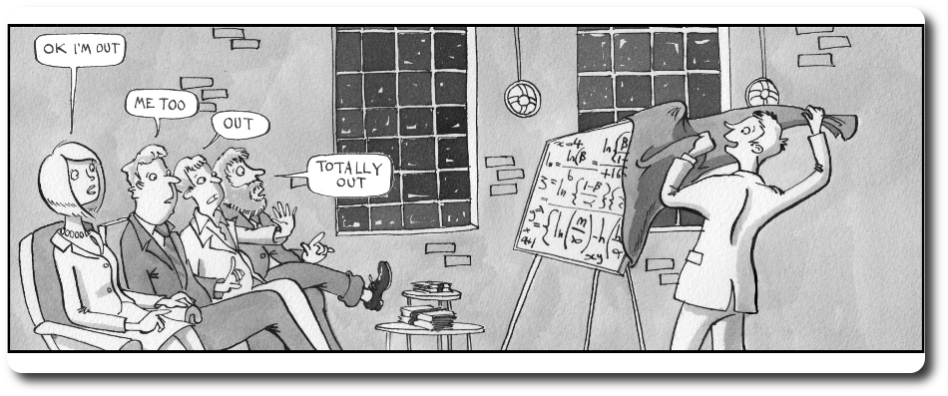
Big Data Revealed
http://www.thebigdatainsightgroup.com/site/article/big-data-talk-003-getting-board-big-data

Slide 35
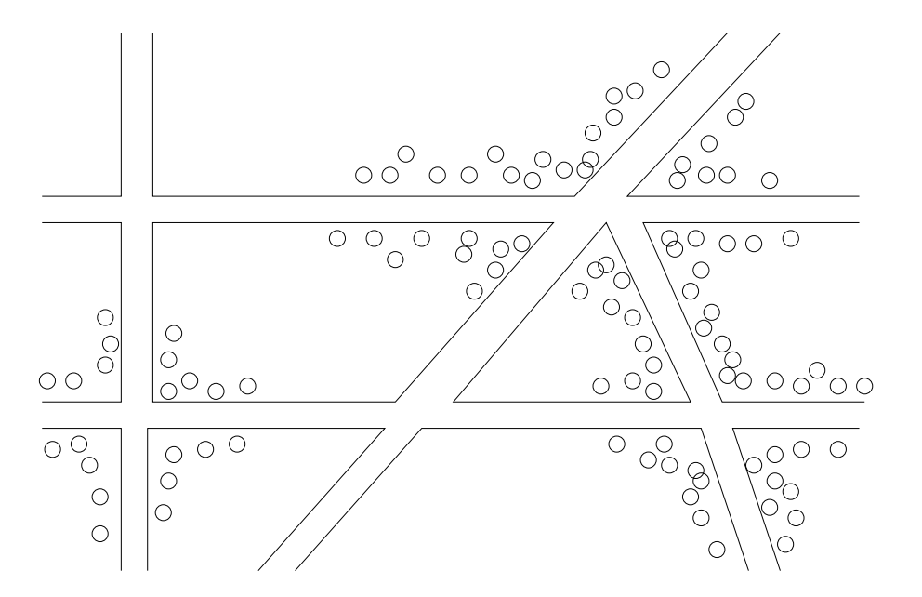
The first “big data” example? The Broadstreet cholera outbreak identified by John Snow
Clustering: the intersection was a well pump. Close to a cesspit.

Slide 36
What is driving big data - II
Make a list of every intimate aspect of your life.
These probably can be inferred (with enough good data and good analysis) from apparently completely independent actions and you will not be aware of the link.

Slide 37
For example…
Gender Childhood Sexuality
Financial status Proclivities Hobbies
Beliefs
Addictions…
How you walk…
How you write…
How your eyes move…
How you breathe…
The tone of your voice…
Your friends…

Slide 38
Why is this?
We use the same parts of the brain for many “trivial” activities as we do for “important” activities.
By observing “trivial” activities (perhaps in great detail) one can decode and infer the important ones…

Slide 39
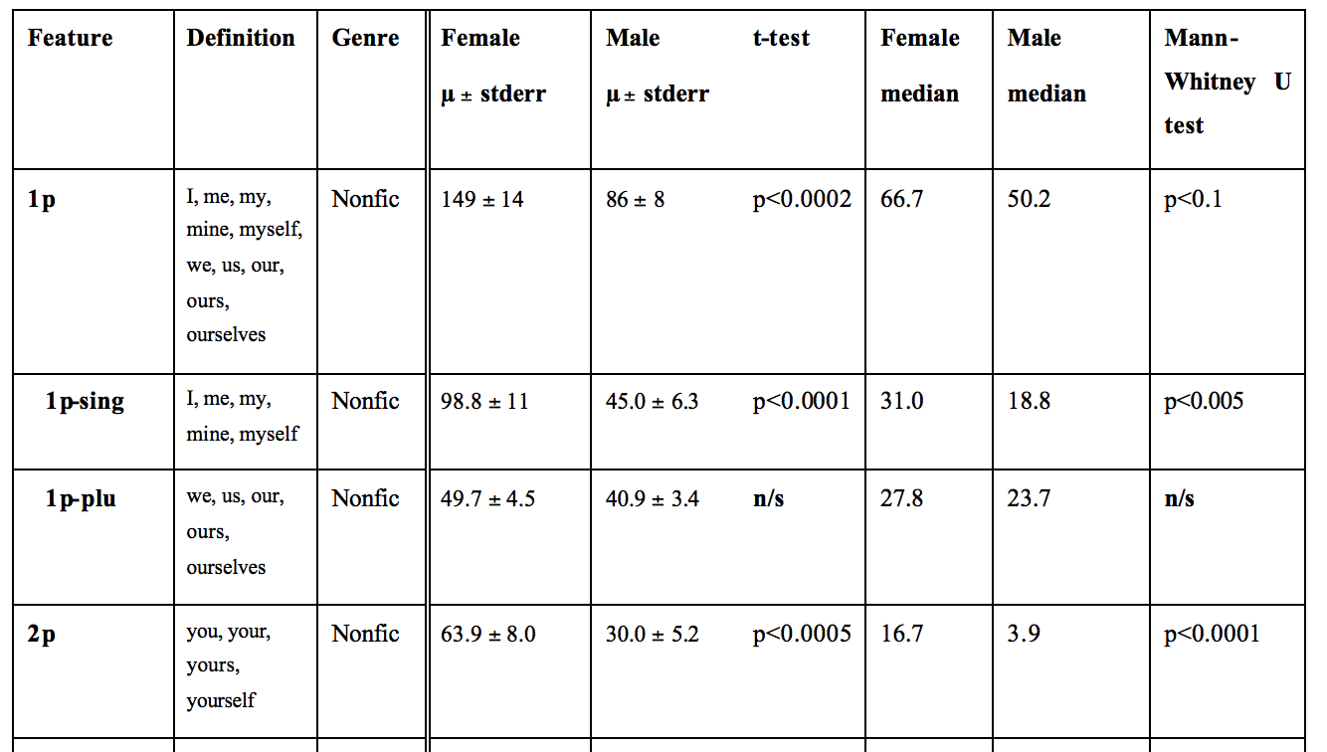
Gender from pronouns
Argamon et al - “Gender, Genre, and Writing Style in Formal Written Texts”

Slide 40
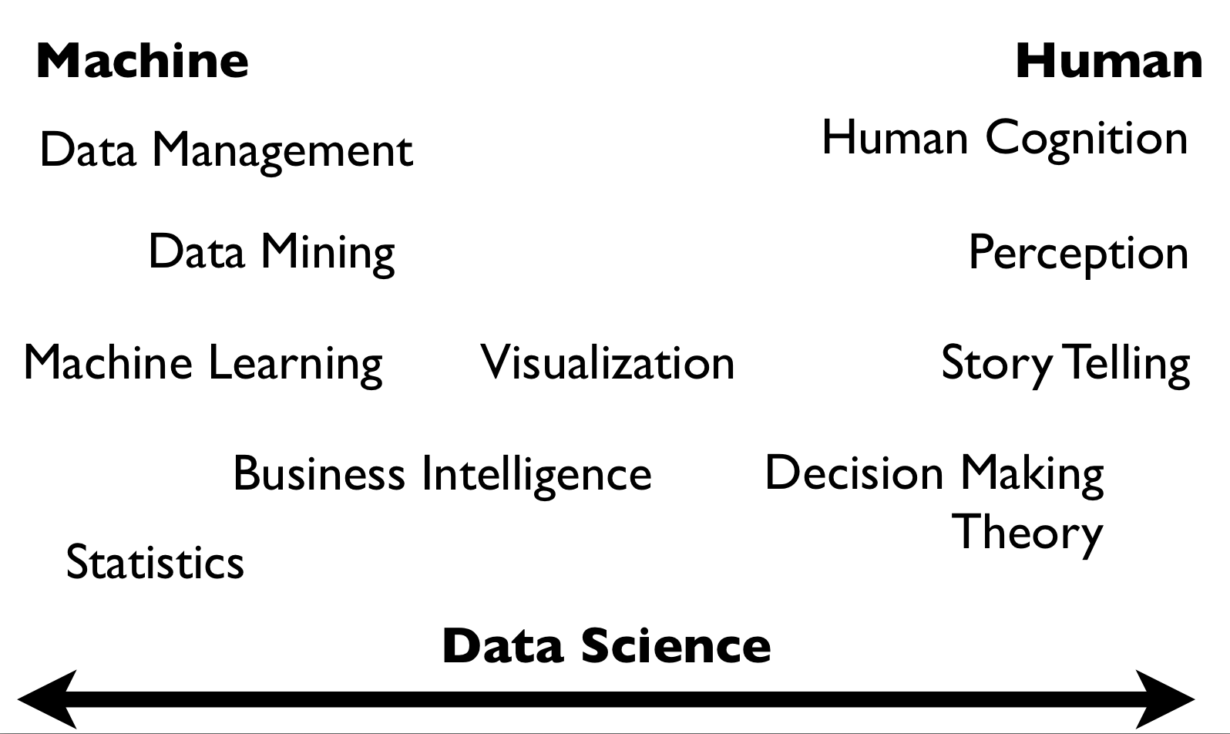
Hanspeter Pfister
& Joe Blitzstein

Slide 41
Any question?

Slide 42
BIG DATA Requirements
Notes:
Label
Era
Framework
<number>

Slide 43
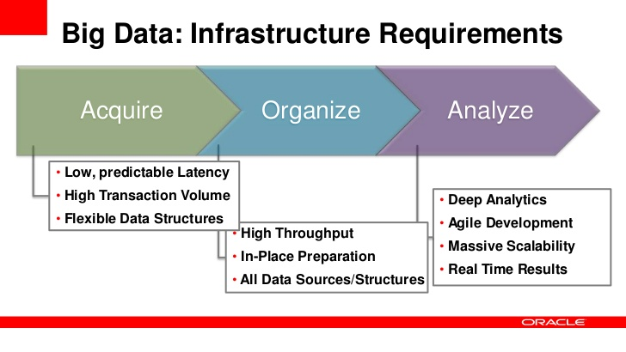

Slide 44
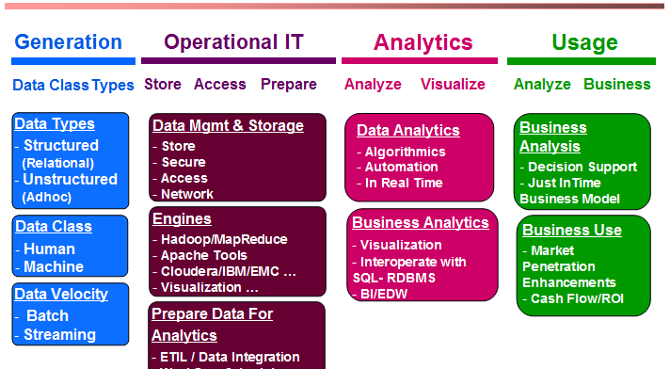
DATA SCIENCE
Machine Learning comes here
http://www.imexresearch.com/newsletters/BDEconomics.html

Slide 45
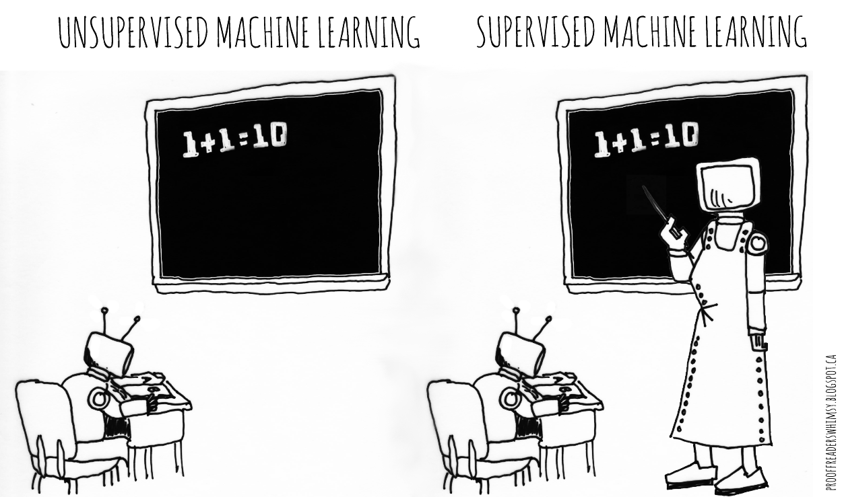
Machine Learning

Slide 46
Data Science

Slide 47
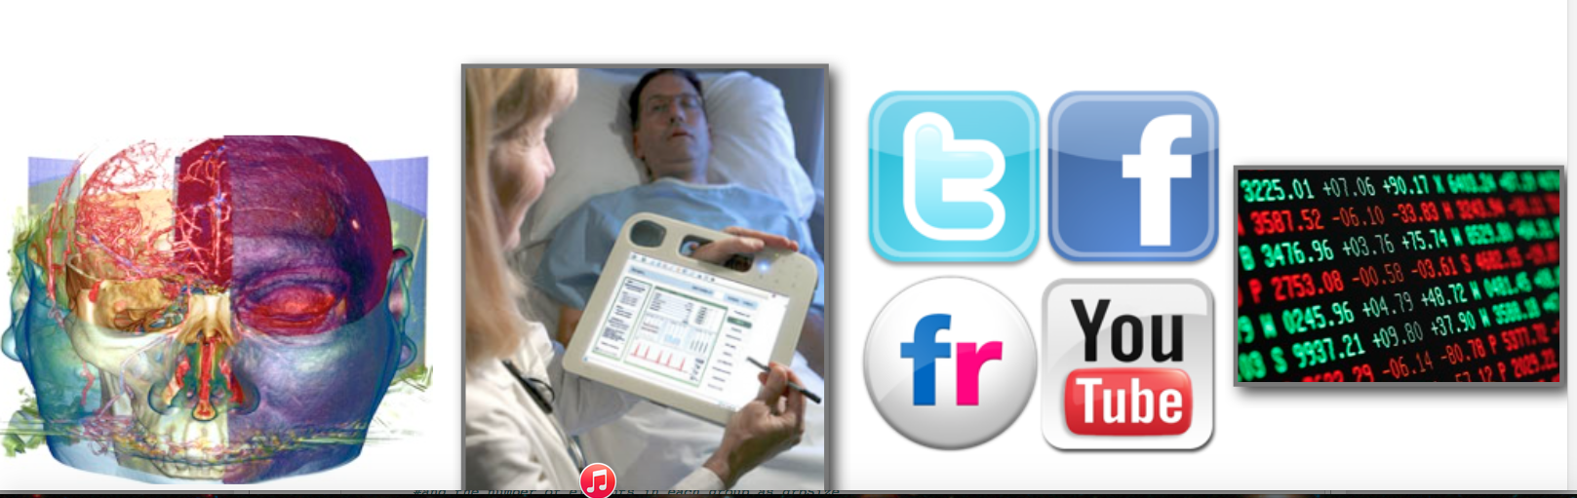
Data Science
To gain insights into data through computation, statistics, and visualization

Slide 48
BIG DATA
DOMAIN SPECIFIC
KNOWLEDGE
Traditional
research
Algorithms
Machine Learning
Hacking skills
COMPUTER
SCIENCE
MATHEMATICS
& STATISTICS
DATA SCIENCE

Slide 49
You are a data scientist!
“A data scientist is someone who knows more statistics than a computer scientist and more computer science than a statistician.”
^{- Josh Blumenstock}

Slide 50
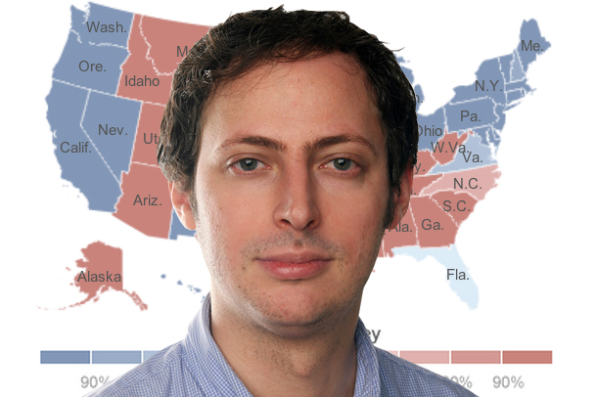
Nate Silver: data scientist
Named as one of The World's 100 Most Influential People by Time

Slide 51
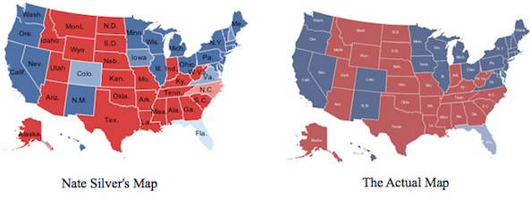
Nate Silver: a data science witch
2012 U.S. elections
Nate Silver prediction:
Barack Obama a 90.9% chance of winning a majority of the 538 electoral votes
predicted the winner of every one of the 50 states and the District of Columbia

Slide 52
Nate Silver Key Principles
use many data sources
understand how the data were collected (sampling is essential) weight the data thoughtfully (not all polls are equally good)
use statistical models (not just hacking around in Excel) understand correlations (e.g., states that trend similarly)
think like a Bayesian
have good communication skills (What does a 60% probability even mean? How can we visualize, validate, and understand the conclusions?)
To learn more about how to predict elections check http://www.padjo.org/2014-10-30/

Slide 53
Reading Assignment
Why Big Data is a Big Deal
http://harvardmagazine.com/2014/03/why-big-data-is-a-big-deal

Slide 54
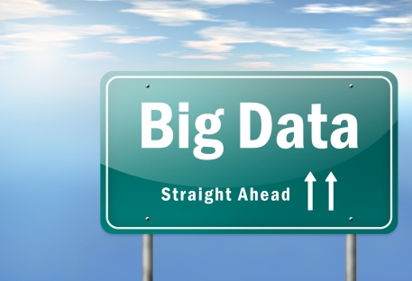
The Course
http://b-i.forbesimg.com/marketshare/files/2013/05/5_big_data.jpg

Slide 55
The course
Review of basic python with ipython notebook
Introduction to Pandas
Introduction to APIs
Machine Learning using scikit-learn
Kaggle Titanic challenge
Project: Twitter data mining

Slide 56
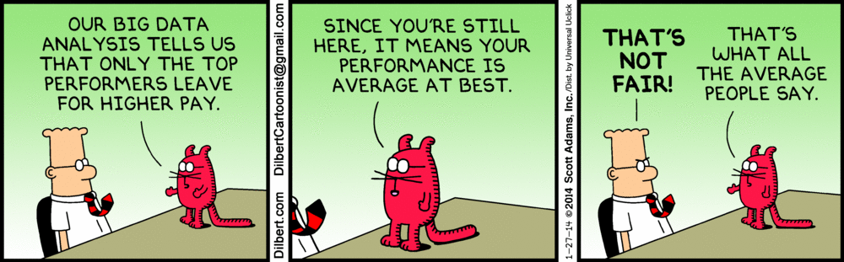

Slide 57
End

Slide 58
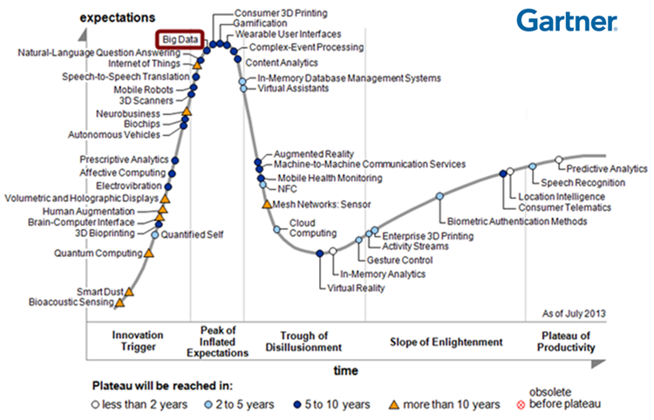
Bug Data Hype

Slide 59
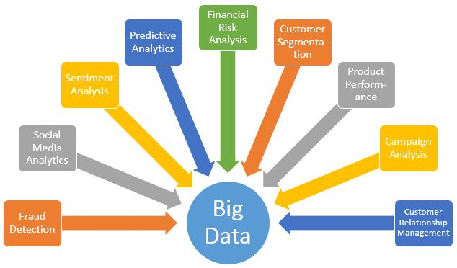

Slide 60
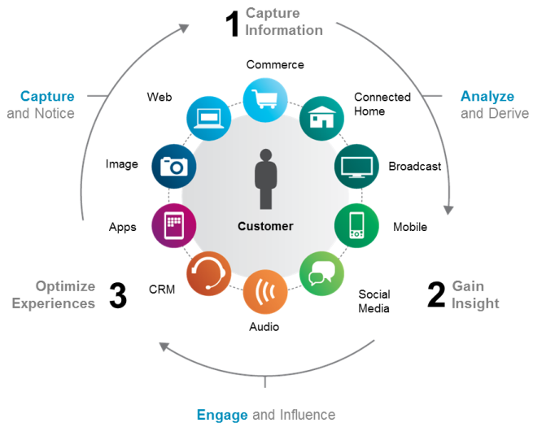

Slide 61
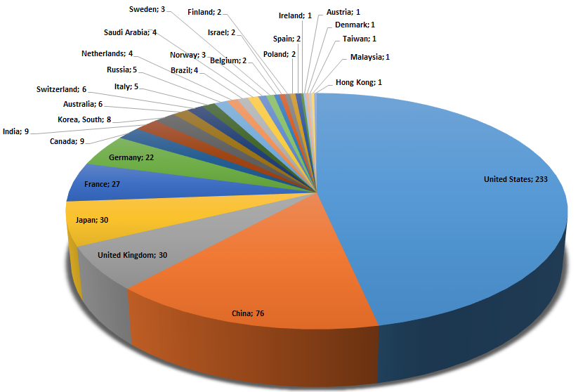
WHY?
WHY?
Supercomputer Share by Countries.
Source: www.top500.org
INVISIBLE AFRICA
Notes:
Many countries have realized the importance of High Performance computing skills for economic development. Moreover, the benefits of Big Data s not difficult if not impossible to realize without HPC skills. African in this respect is under represented as can be seen in this image. No African country is operates HPC that is listed in the TOP 500. In this regard, It is one of my main goal create awareness and provide courses on high performance computing in different AIMS centers as well as Mauritius and Ethiopia.

Slide 62
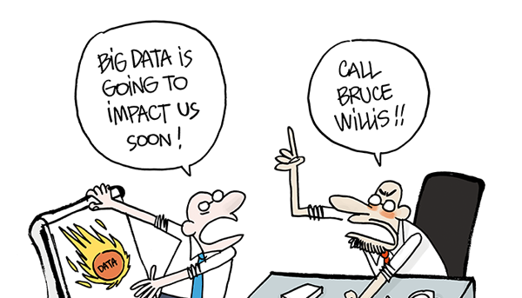
https://www.linkedin.com/pulse/big-data-use-case-understanding-role-ontology-plays-pete-ianace

Slide 63
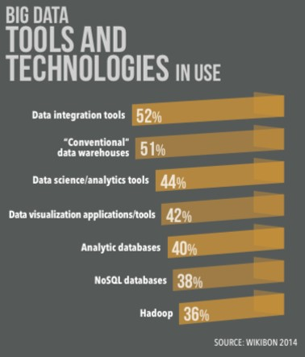

Slide 64
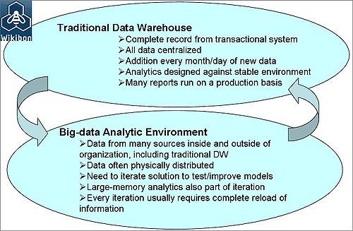
Data vs Big Data

Slide 65
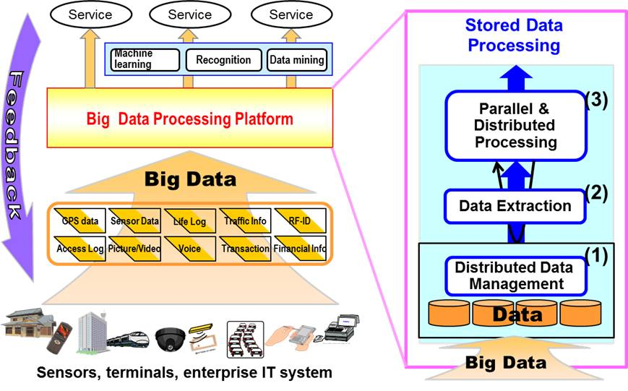

Slide 66
Big Data Components
Data Sources: operational and functional systems, machine logs and sensors, Web and social and many other sources
Data Platforms, Warehouses and Discovery Platforms: that enable the capture and management of data, and then – critically – its conversion into customer insights and, ultimately, action
Big Data Analytics Tools and Apps: the “front end” used by executives, analysts, managers and others to access customer insights, models scenarios and otherwise do their jobs and manage the business.

